Slide 1
Presidency School of Artificial Intelligence and Advanced Computing
Department of Data Science and Computing Systems
1st Sem M.Tech. [Data Science]
PROJECT ZEROTH REVIEW
Edge-AI-Based Early Plant Disease Detection Using IoT Vision Sensors and Lightweight CNNs
PRESENTED BY,
ADITYA SHARMA
20262DSC0008
Mtech(Data Science)
GUIDED BY,
Dr. S. Pravinth Raja
HOD

Slide 2
Agenda
Research Area
Problem Statement
Motivation
Literature Survey
Research Gap
Proposed Idea
Novelty
Proposed Titles
Final Selected Title
Objectives
References

Slide 3
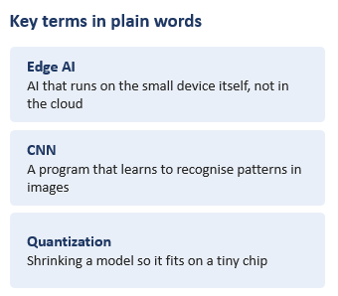
Research Area
BROAD DOMAIN:
Artificial Intelligence in Smart Agriculture.
ENABLING TECHNOLOGY
Edge AI: AI that runs on the device, not the cloud.
SPECIFIC AREA
Early rice leaf disease detection with small CNNs on a low-cost camera device.
Notes:
from top to bottom. Broad field: using AI in farming. Technology: Edge AI, which just means the AI runs on the small device instead of in the cloud. Specific area: spotting rice leaf disease early with small image-recognition programs (CNNs) on a cheap camera device. The three terms on the right are the only jargon in this talk. If asked 'what is a CNN?', say: a program that learns from many labelled photos to recognise patterns, such as a diseased leaf. If asked 'what is quantization?', say: making the model's numbers less precise so that it takes less memory and runs faster on a tiny chip.

Slide 4
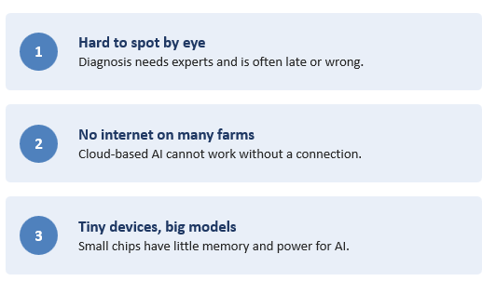
Problem Statement
How can a small, cheap device spot crop disease early, without internet?
PROBLEM
Farmers need to spot rice leaf diseases early. But experts are few, cloud AI needs internet, and small devices cannot run big AI models.

Slide 5
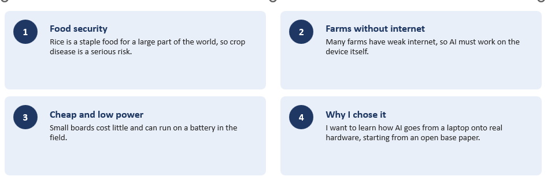
Motivation
Why the problem matters, and why I selected it

Slide 6
Literature Survey
Five recent studies on plant disease detection with small devices
Paper | Device | What they did | What they found
De Vita et al. (2020) | STM32 chip | Shrank a CNN to detect coffee plant diseases | 96% accuracy on the chip
Mishra et al. (2020) | Raspberry Pi 3 + AI stick | Detected corn leaf diseases in real time | 88.46% accuracy, no internet
Rumy et al. (2021) | Raspberry Pi 4 | Built an IoT system for rice leaf disease | Works in real time on the device
Khan et al. (2023) | Smartphone app | Compared YOLO models on maize leaf disease | YOLOv8n best, 99.04%
Xan et al. (2024), base paper | STM32H747I board | Tested 5 small CNNs on 4 rice diseases | 98.75% in the lab, 90% on the device

Slide 7
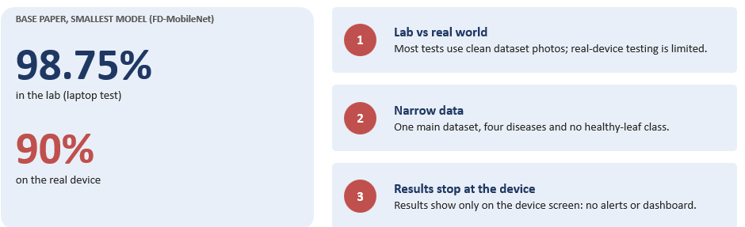
Research Gap
Good lab results do not yet guarantee good real-world results

Slide 8
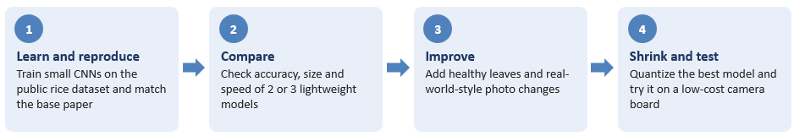
Proposed Idea
Start by reproducing the base paper, then improve it step by step
To decide with my guide
Which board and camera to use
Which extra dataset to use for healthy leaves
How much to reproduce and how much to improve in the first semester

Slide 9
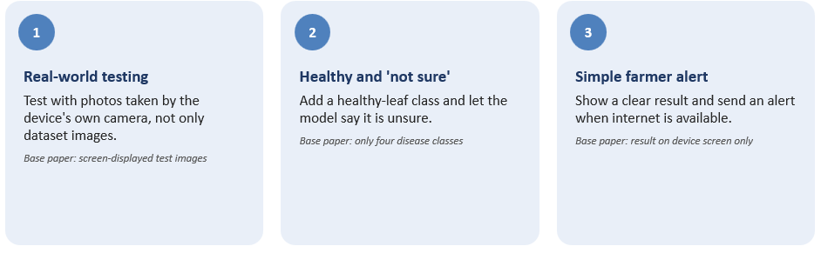
Novelty
Small, realistic additions to the base study (to be refined with my guide)

Slide 10
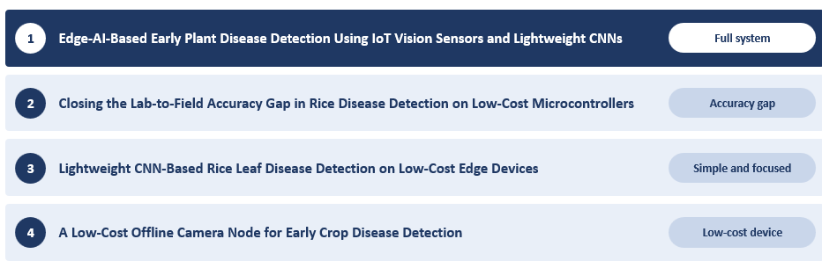
Proposed Titles
Four candidates drawn from the research gap

Slide 11
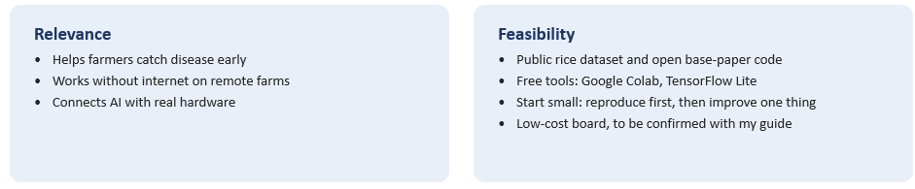
Final Selected Title
RECOMMENDED TITLE
Edge-AI-Based Early Plant Disease Detection Using IoT Vision Sensors and Lightweight CNNs

Slide 12
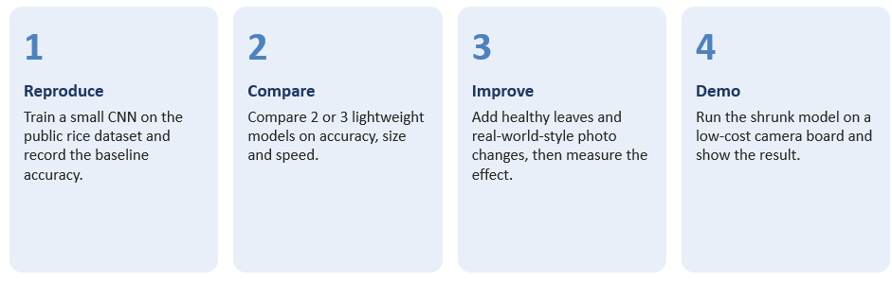
Objectives
Four preliminary objectives

Slide 13
References
[1] C. J. Xan, H. Nugroho, S. Eswaran, and T. F. Siang, "Effective edge solution for early detection of rice disease on ARM-M microcontroller," IEEE Access, vol. 12, pp. 148267-148280, 2024, doi: 10.1109/ACCESS.2024.3470970.
[2] F. De Vita et al., "Quantitative analysis of deep leaf: A plant disease detector on the smart edge," in Proc. IEEE SMARTCOMP, 2020, pp. 49-56, doi: 10.1109/SMARTCOMP50058.2020.00027.
[3] S. Mishra, R. Sachan, and D. Rajpal, "Deep convolutional neural network based detection system for real-time corn plant disease recognition," Procedia Comput. Sci., vol. 167, pp. 2003-2010, 2020, doi: 10.1016/j.procs.2020.03.236.
[4] S. M. S. H. Rumy, M. I. A. Hossain, F. Jahan, and T. Tanvin, "An IoT based system with edge intelligence for rice leaf disease detection using machine learning," in Proc. IEEE IEMTRONICS, 2021, pp. 1-6, doi: 10.1109/IEMTRONICS52119.2021.9422499.

